Slide 1
One-Shot Learning
2d Lt David Crow

Slide 2
Overview
Motivation
Implementation
Applications
Omniglot

Slide 3
Motivation
A standard classifier …
A siamese neural network …
Learns every class
Can classify a sample from a known class
Can classify a sample from an unknown class as Unknown Class by setting a threshold
Cannot discriminate between unseen classes
Is not extensible to new classes
Learns similarity
Can classify a sample from a known class
Can classify a sample from an unknown class as New Class X by setting a threshold
Can discriminate between unseen classes
Is extensible to new classes

Slide 4


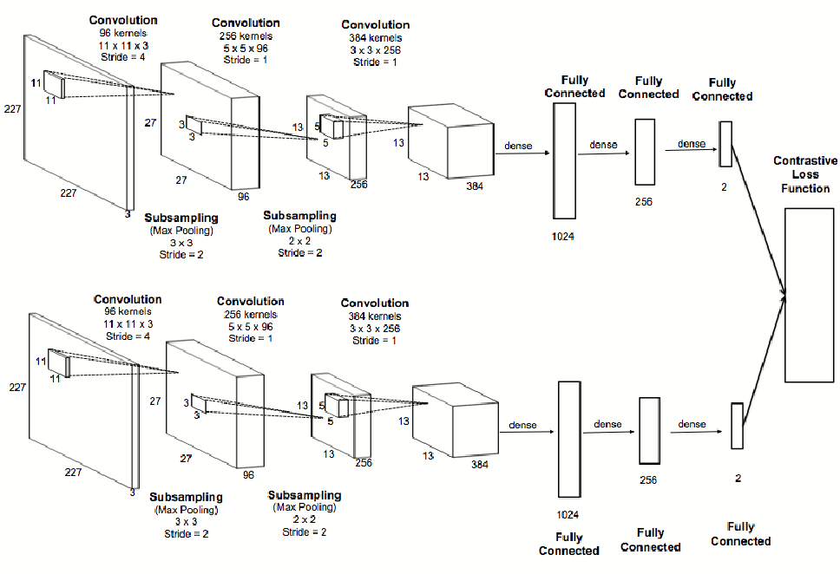
Implementation

Slide 5
Applications
FaceID
Signature verification
Fingerprinting vehicles

Slide 6
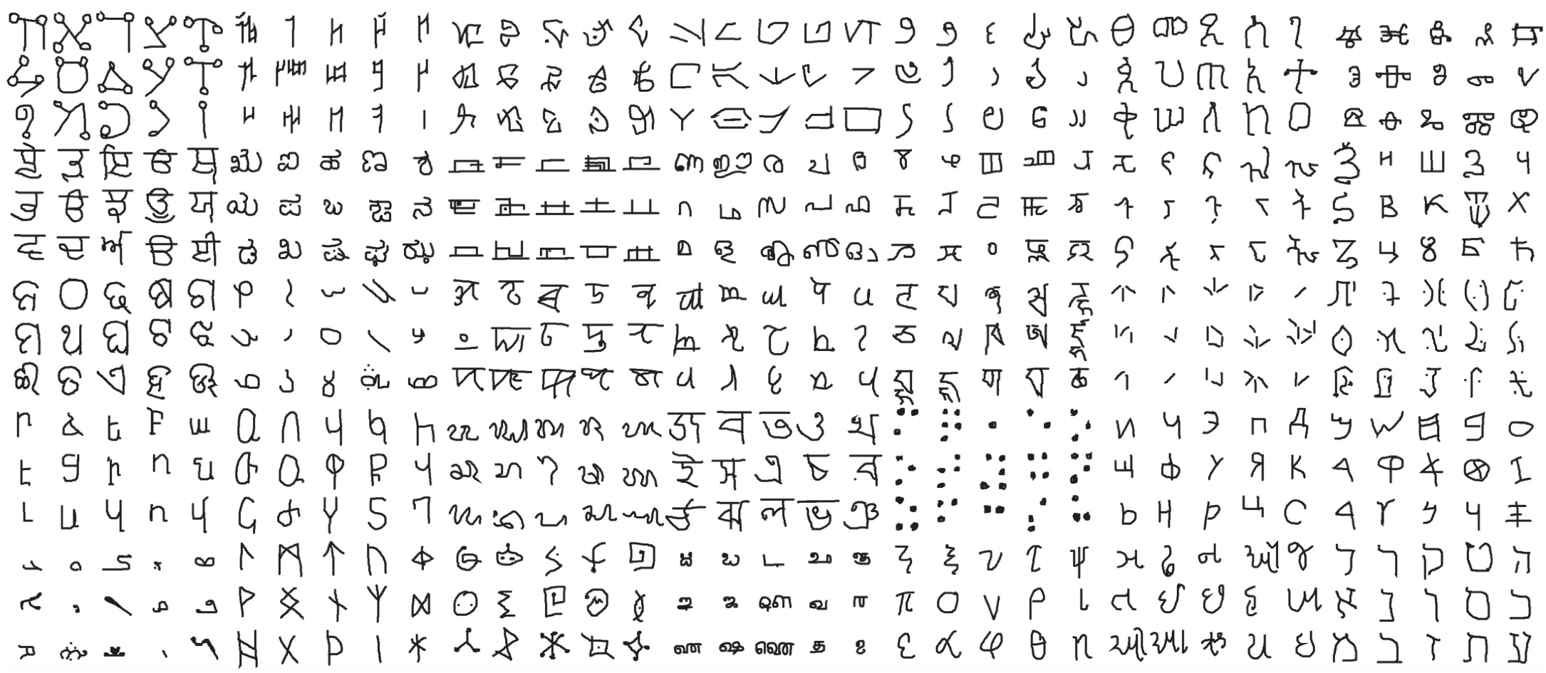
Omniglot
Transpose of MNIST
1,623 characters (50 alphabets)
20 samples per character
Background: 30 alphabets
Evaluation: 20 alphabets

Slide 7
References
Burkov, A. (2019). The hundred-page machine learning book. Quebec City, Canada: Andriy Burkov.
Koch, G., Zemel, R., & Salakhutdinov, R. (2015). Siamese neural networks for one-shot image recognition. In ICML deep learning workshop (Vol. 2).
Dey, S., Dutta, A., Toledo, J. I., Ghosh, S. K., Lladós, J., & Pal, U. (2017). Signet: Convolutional siamese network for writer independent offline signature verification. arXiv preprint arXiv:1707.02131.
Siamese Networks: Algorithm, Applications And PyTorch Implementation
Lake, B. M., Salakhutdinov, R., &Tenenbaum, J. B. (2015). Human-level concept learning through probabilistic program induction. Science, 350(6266), 1332-1338.
One Shot Learning and Siamese Networks in Keras
One Shot Learning with Siamese Networks using Keras

